Slide 1
Liver Transplantation: 50 years
Milan Kinkhabwala, MD
Professor of Surgery
Director of Abdominal Transplantation
Montefiore Einstein Center for Cancer Care

Slide 2
History of Transplant
Understanding of Alloimmunity: Medawar et al 1950’s
First successful solid organ transplant 1954
First successful immunosuppressive therapy (Corticosteroids and Azathioprine) 1963
Liver transplant 1967
Heart transplant 1967
Calcineurin inhibitor (Cyclosporine) 1977

Slide 3
National Organ Transplant Act 1984
Created the Organ Procurement and Transplant Network (OPTN) under HHS
Management of OPTN contract awarded to UNOS
Creation of 11 Regions in the US
Scientific Registry to Evaluate Outcomes and Provide Data for Policy Development
2007 CMS published regulations governing transplant practice, linked payment to quality, and established routine on site surveys of programs

Slide 4
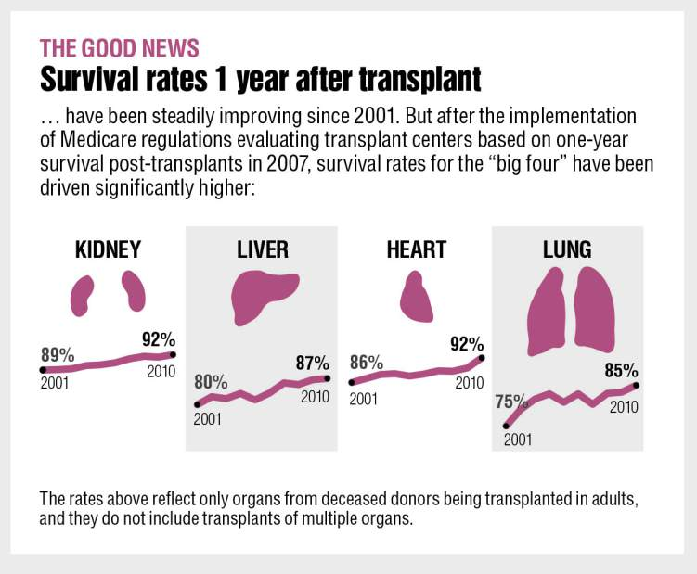
Success rates of the common solid organ transplants is now approximately 90% at one year
Standardized surgical technique
Improved immunosuppressive and medical management
Improved multidisciplinary care and patient selection

Slide 5
Requirements for organ transplantation is similar in all organs
Must have irreversible organ failure or an organ based condition whose only reasonable therapeutic option is transplant
Transplant should prolong survival
Medical condition must permit safe transplant surgery and recovery
Must be able to comply with follow up pre and post operatively for life

Slide 6
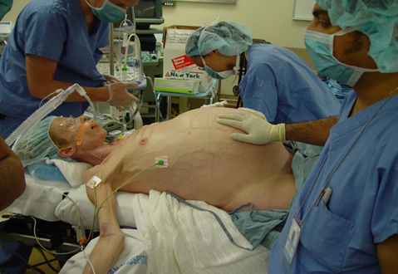
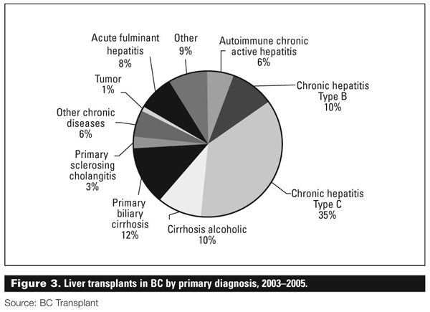
Liver transplantation is a treatment for irreversible liver failure

Slide 7
Emerging indications for LT

Slide 8
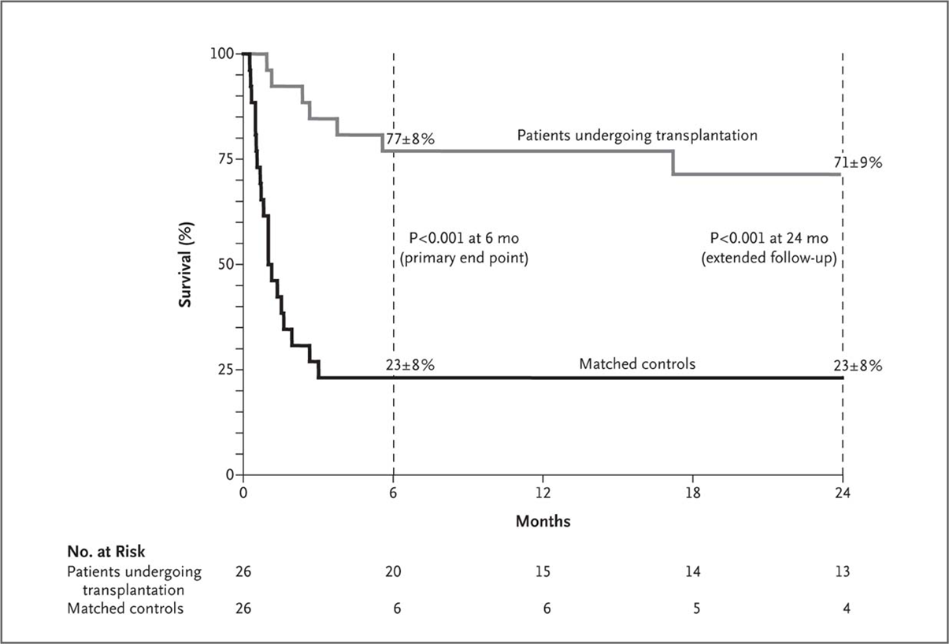
Original Article Early Liver Transplantation for Severe Alcoholic Hepatitis
N Engl J Med
Volume 365(19):1790-1800
November 10, 2011

Slide 10
How does a patient get placed on the waiting list?
Completion of an education and medical assessment process at the transplant center with a multidisciplinary team, which includes an assessment of social supports and financial clearance.
Completion of required testing (blood, imaging, cardiac, cancer screening, etc.)
Registration in United Network for Organ Sharing (UNOS) for placement on the list, based on blood type and organ

Slide 11
Maintaining liver disease patients on the wait list
Average wait list mortality in the U.S. is about 10%
Mortality is related to severity of illness
Bleeding
Infections
Multiorgan failure
Progression of disease (cancer)

Slide 12
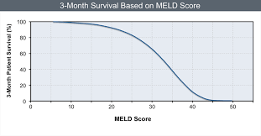
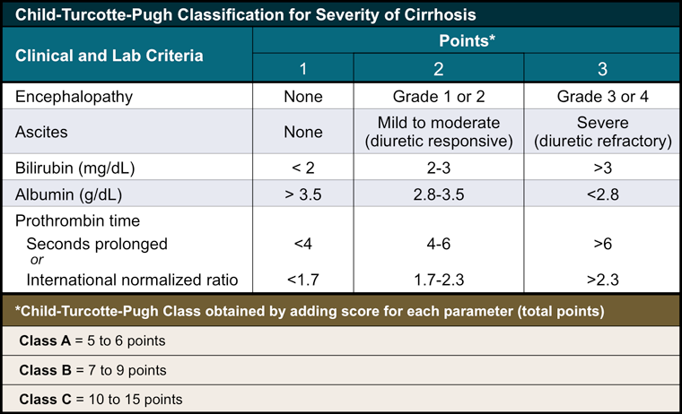
How are organs placed? Scoring Chronic Liver Disease
MELD Score determines rank on the wait list,
Not waiting time on the list

Slide 13
Meld exceptions (extra points allocated for specific conditions)
Standard allocation by UNOS: Liver cancer
Regional Review Board allocated (committee)

Slide 14
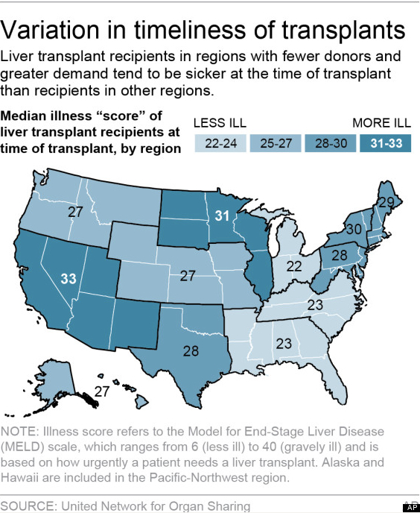
Median Meld at Transplant

Slide 15
Geographic variability in access to liver transplant

Slide 16
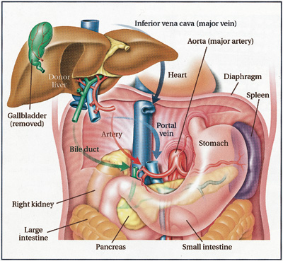
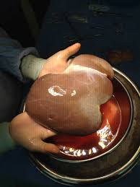
Standard Liver Transplantation Technique
1.Total Hepatectomy
2.Orthotopic placement
3.Anastamoses: Supra and Infra IVC, Portal Vein, Hepatic Artery, Bile Duct

Slide 17
Modern immunosuppressive therapy in liver transplantation is based on three oral agents
Calcineurin inhibitors (Cyclosporine and Tacrolimus) work by blocking activation of T Cells
Antiproliferative agents (Azathioprine, Mycophenolate, Rapamycin) work by inhibiting T cell proliferation
Steroids are nonspecific inhibitors of cell signalling responsible for T cell activation

Slide 18
Recurrent Disease
HCV
PSC
NAFLD
Autoimmune
Cancer

Slide 19
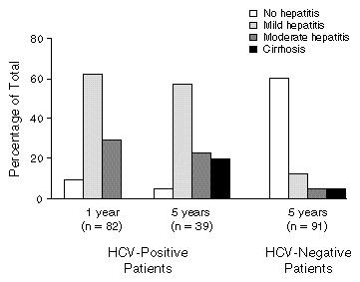
Biopsy Findings One and Five Years after Liver Transplantation in Recipients with HCV Infection after Transplantation and in Those without HCV Infection.
Gane EJ et al. N Engl J Med 1996;334:815-821.
Notes:
Figure 1. Biopsy Findings One and Five Years after Liver Transplantation in Recipients with HCV Infection after Transplantation and in Those without HCV Infection. The number of patients in each group is given in parentheses. P<0.001 for the comparison of each variable between the HCV-positive and HCV-negative groups at five years.

Slide 20
Recurrent Liver Damage due to HCV: Risk is Decreasing

Slide 21
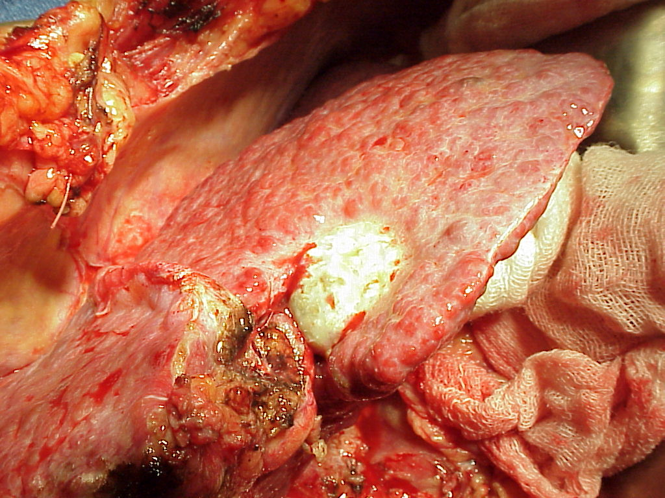
Validation of Liver Transplantation (total hepatectomy) as a Therapeutic Modality for HCC
4 year disease free survival of 92% can be achieved for small unresectable HCC’s if specific imaging based tumor criteria are met.
Disease free survival was 59% if tumor exceed criteria.
Mazaferro et al, 1996

Slide 22
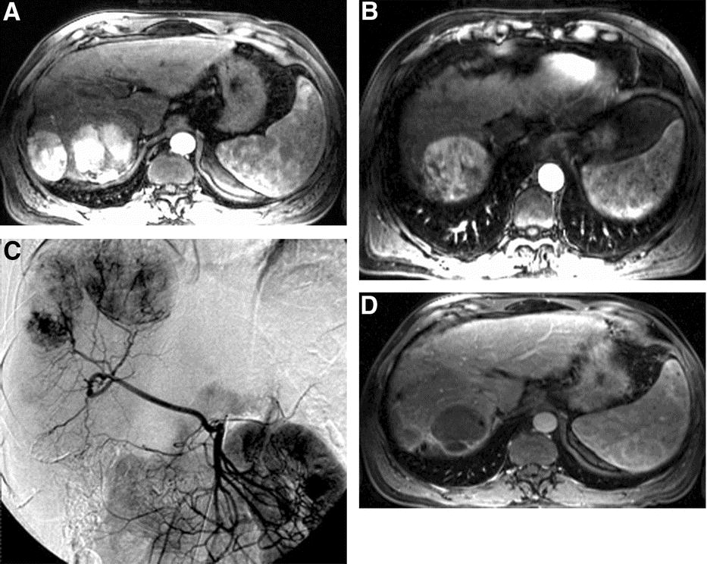
Bridge therapy to control liver cancer
TACE
Y90
Ablation
Sorafenib

Slide 23
Expanding the life boat—finding innovative ways to increase access to transplant
Live donor and split liver transplant
Using expanded criteria donor organs
Donors with HCV

Slide 24
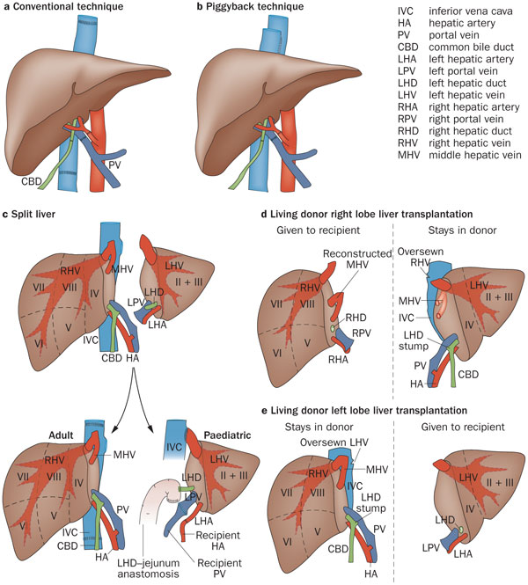
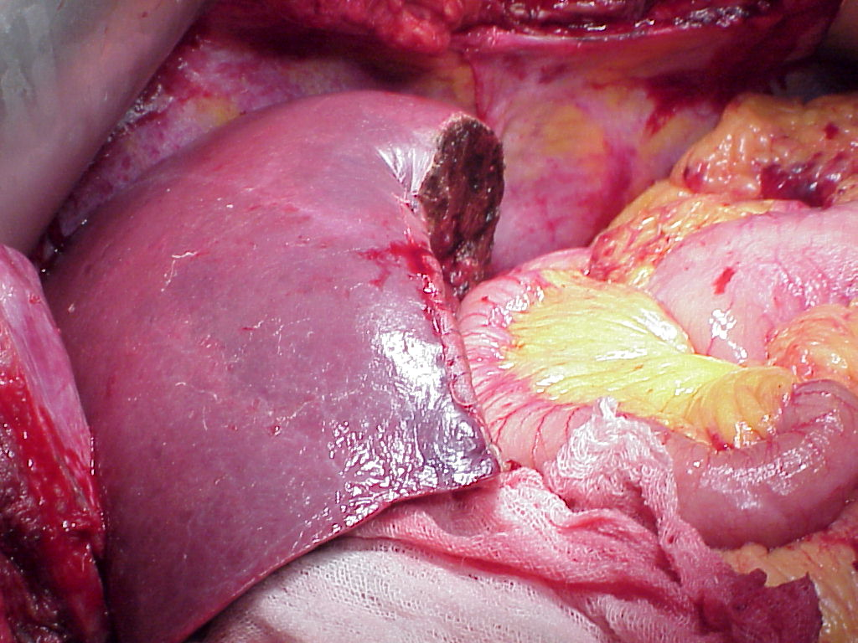
Reduced and split liver techniques

Slide 25
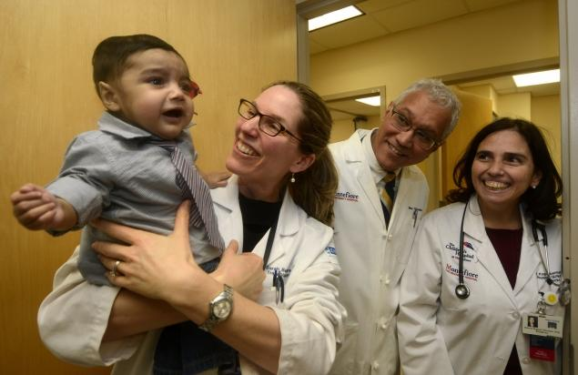
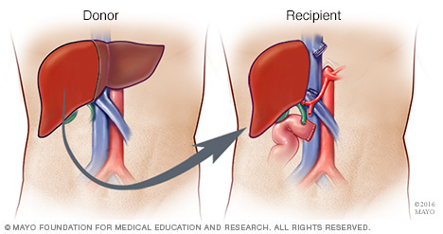
Live donor transplantation: especially important for children but also used for adults
Approximately 90% of adult transplants in the US are from deceased donors, 10% from live donors (reversed ratio in Asia)

Slide 26
Conclusions
Liver transplantation is highly successful in treating end stage liver failure, but there are significant issues that remain:
Organ Supply and Geographic Variations in Access
Optimal utilization of ECD and Live Donor Grafts
Long term effects of Immunotherapy
Optimal role of transplantation in some conditions like HCC
Emerging Diseases
Optimal timing of HCV therapy

